Slide 1
Trans Health in Cancer Genetic Counseling
Kailun Huang, Xuechun Liu, Liwen Zhang
Notes:
How representative of the samples?
If the participants who left blank in the demographic questions also left blank for all cases studies?

Slide 2
Project Background
Client: Tala Berro, Genetic Counseling Student
PhD Mentor: David Reynolds, Teaching Fellow
Dataset: 7 cases studies, 2 are qualitative, 1 has no objectively correct answer (primary focus on 4 of them)
Description: Study is about cancer genetic counselors’ anticipated behaviors when counseling transgender patients
Null Hypothesis: Clinician experience and demographics have no effect on the performance on case study questions (as measured by Jaccard Index)

Slide 3
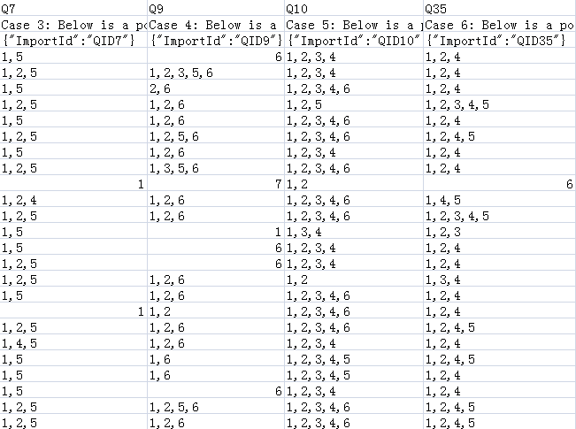
Data Overview
Case 3 -- Question 7
answers are 1, 2, 5
Case 4 -- Question 9
answers are 1, 2, 6
Case 5 -- Question 10
answers are 1, 2, 3, 4, 6
Case 6 -- Question 35
answers are 1, 2, 4, (5)

Slide 4
Independent Variables Overview
The potential covariates broadly fall into two main categories
Clinician Experience
Number of patients seen each month (<40, ~40, >40)
Number of years spent working in a cancer setting
Seen any transgender patients?
Any transgender specific education/ training?
Clinician Demographics
Age
Gender identity
Sexual orientation
Race
Region of practice

Slide 5
Dependent Variable - Jaccard index
# of (Participant’s answer ∩ Correct answer)
Jaccard Index = ______________________________________
# of (Participant’s answer ∪ Correct answer)

Slide 6
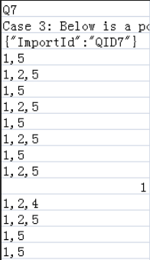
Jaccard Index Example
Case 3 -- Question 7
answers are 1, 2, 5
Case 4 -- Question 9
answers are 1, 2, 6
Case 5 -- Question 10
answers are 1, 2, 3, 4, 6
Case 6 -- Question 35
answers are 1, 2, 4, (5)
0.5

Slide 7
Representative EDA
The following slides present visualizations that we performed for each of the case studies. This particular case study (Case Study 3/ Q7) setup is:
A 50-year-old trans woman is referred to genetic counseling due to a significant family history of prostate cancer. During the session, the patient informs you that she had a vaginoplasty and has undergone hormone replacement therapy for seven years. Other than a normal colonoscopy she recently had, she has had no cancer screening. Select all the topics that are relevant to this patient’s medical care and her gender affirmation:

Slide 8
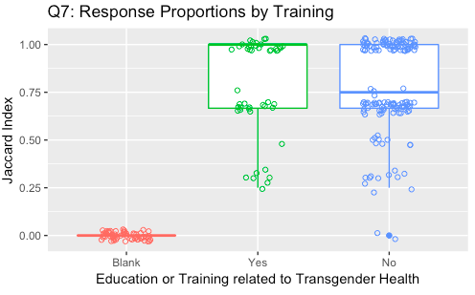
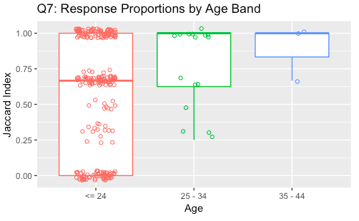
Representative EDA - Case Study 3/ Q7

Slide 9
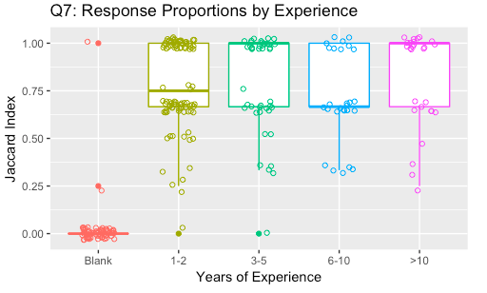
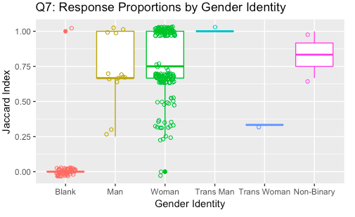
Representative EDA - Case Study 3/ Q7

Slide 10
Modeling Overview
For each of the four case studies, we fit logistic regression models with Jaccard Index as the dependent variable and all demographic and experience variables as covariates
The models we fit have no variables significant at alpha=0.05
We accept the null hypothesis that no variables have effects on the jaccard index on each case.

